Slide 1
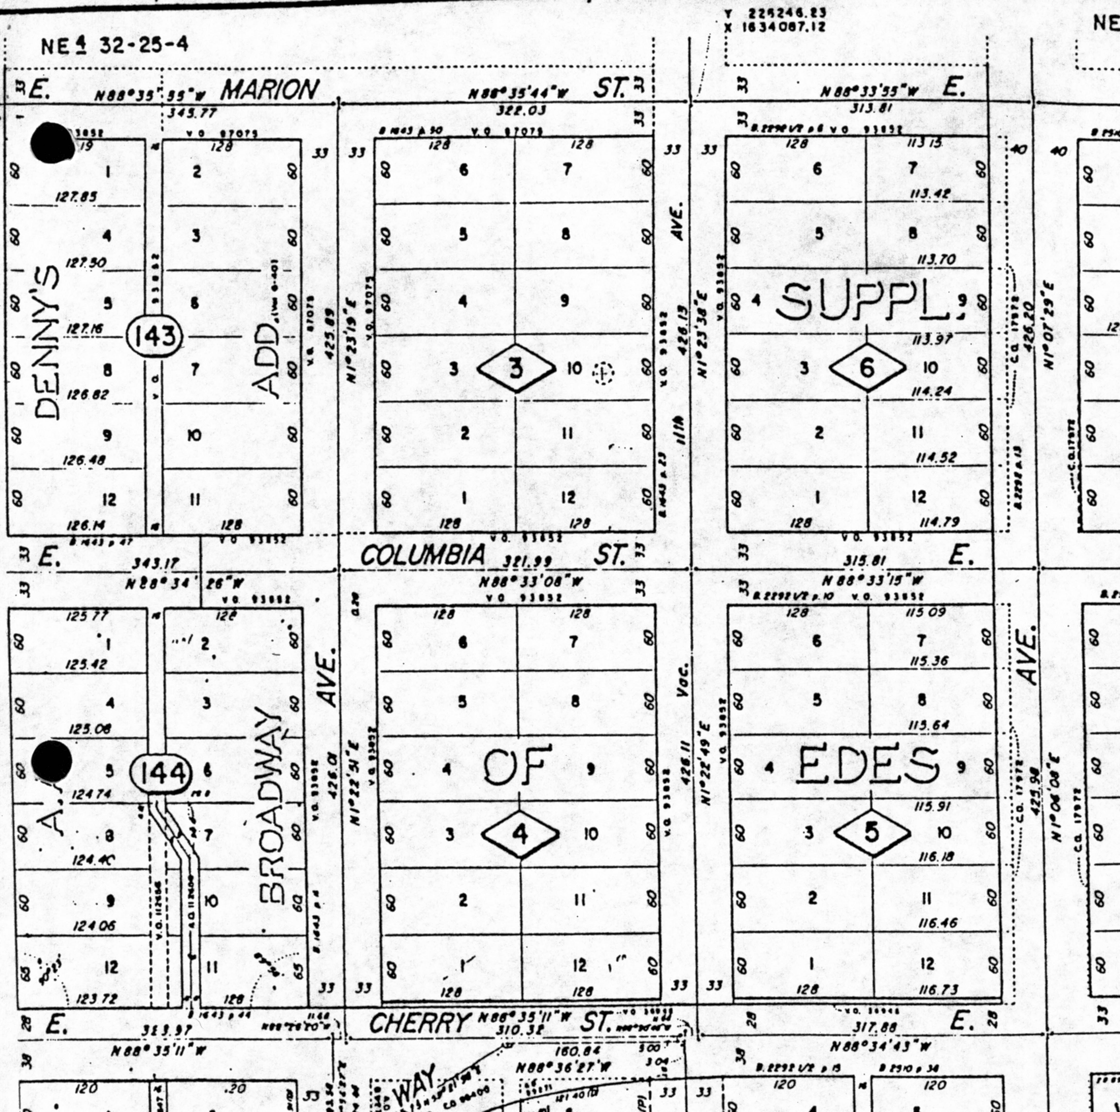
CHAPTER 6 – TRAVERSE SURVEYS

Slide 2
6.1 Open and Closed Traverses
Traverse = a series of measured lines connected by measured angles
Closed traverse = begins on a point of known position and closes to another point of known position (often a closed loop on the initial point). When closing to a different point of known position, it is called a connecting traverse.
Open traverse = begins at a known point and goes to another point whose location is uncertain. This point cannot be checked for error except by another traverse.

Slide 3
6.2 What traverses are used for
Traverses provide horizontal coordinates of points and bearings-distances between control (+permanent) points; sometimes also elevations
Usually level loops provide elevations of control points.
1) Topographic Surveys
2) Control Surveys
3) Boundary Surveys

Slide 4
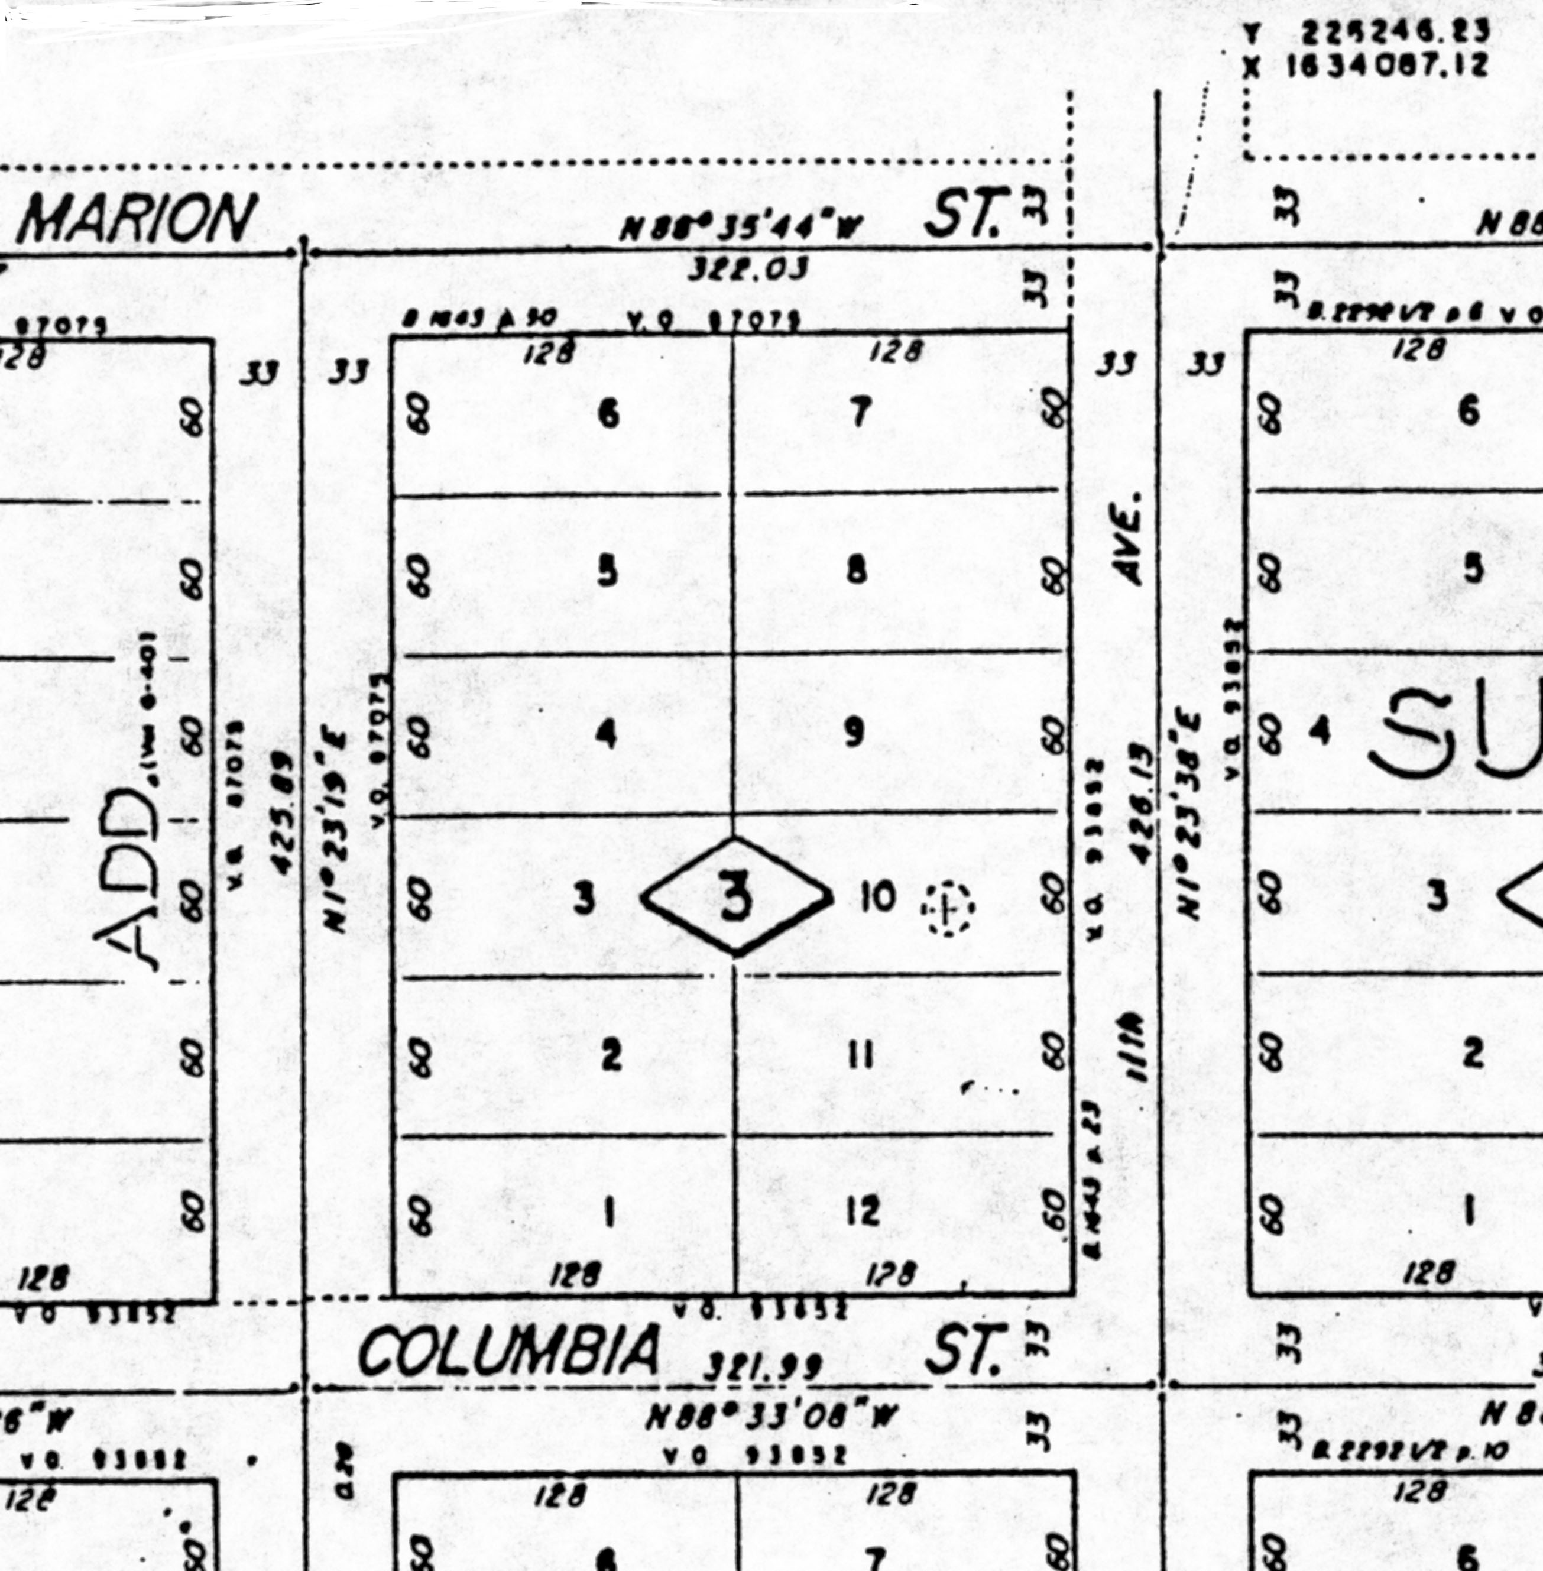
Example: Closed Traverse of Field Exercise #6

Slide 5
6.3 Balancing angles in a traverse
Balancing angles = adjust the angular error of closure of a closed figure = first step in the procedure to correct errors in a closed figure traverse
Interior angles = angles formed within a closed figure
Theorem: For all closed polygons of n sides:
S interior angles = (n-2) x 180º

Slide 6
Procedure for balancing angles
Step 1: Locate blunders in angle measurements
Step 2: Adjust angular closure error
Three methods:
1) adjust angles equally
2) arbitrary: adjust weaker shots
3) adjust angles with the shortest lines of sight

Slide 7
6.4 Allowable angular closure
By double-centering, you should be able to measure an angle to the nearest 15" using a 30" theodolite. Theoretically better results if you measure more, say 6 times (3 direct accumulating the angles, then 3 reverse; then divide total by 6).
Rule of Thumb: angle closure < least count on vernier x ( n )^{0.5} ,
where n = no. of measurements
Example: Elta 50R is a 5” gun. Thus, E.C. should < 5” ( n )^{0.5}

Slide 8
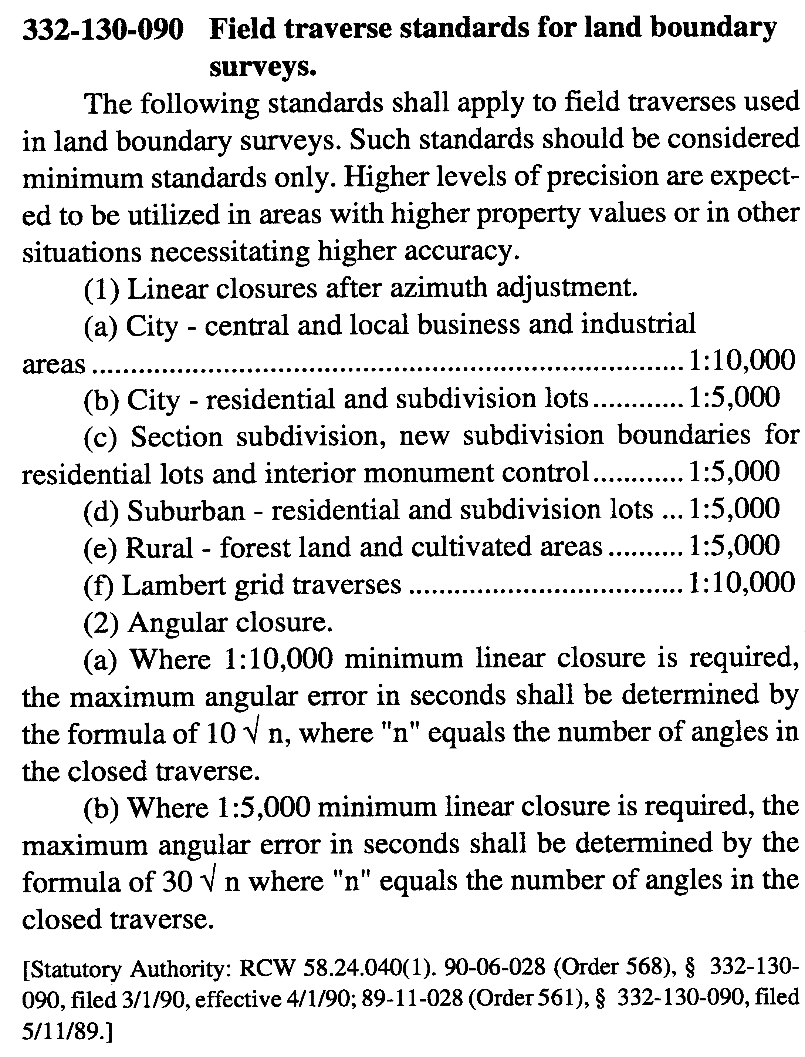
Requirements for Boundary Surveys
(WAC 332-130-090)
See Record of Survey Ref. Mat. #35

Slide 9
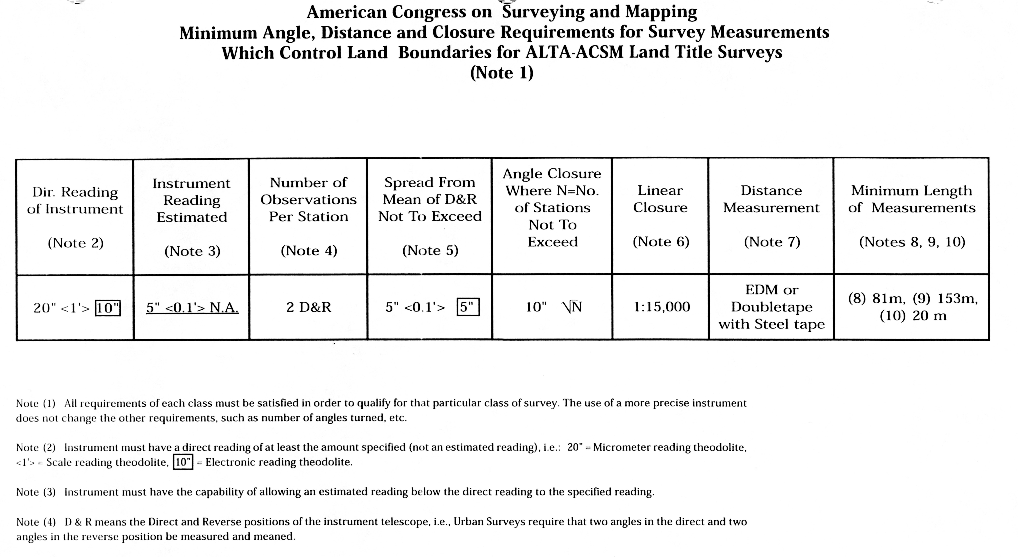
ALTA surveys for “extended” property title insurance (Ref. Mat. 10)

Slide 10
6.4 Latitudes and Departures
Latitude of a line = distance in the N-S direction of that line
Lat = H cos a
Departure of a line = distance in the E-W direction of that line
Dep = H sin a
Example:

Slide 11
Recall the four quadrants of the full compass circle. These are useful in
determining whether latitudes and departures are positive or negative:

Slide 12
6.5 Error of Closure
If you start at the beginning and walk around a closed traverse you will have walked as far north as south, and as far east as west:
S latitudes = 0 S departures = 0
But we typically have an error of closure due to errors in linear and angular measurements:
E latitudes = Error in latitude (E_{L})
E departures = Error in departure (E_{D})

Slide 13
The traverse closure is the line that will exactly close the traverse. The angle it makes with the meridian is
The length of the traverse closure line is

Slide 14
When is it reasonable to correct for traverse error of closure?
If relative accuracy is satisfactory, i.e., if relative accuracy meets
rural land 1:5000
suburban 1:7500
urban 1:10000
then your survey may be considered free of blunders or badly adjusted instruments, etc. Then balance the errors in latitudes and departures to “close” or “balance” the traverse.

Slide 15
6.6 Summary of Computations for Balancing a Traverse
The steps in balancing a traverse are:
1) Compute the angular error and adjust to make S angles = (n-2) 180º
2) Compute the bearings for each course (using the adjusted angles)
3) Compute the latitudes and departures
4) Compute the error of closure
5) Compute the relative accuracy (accuracy ratio).
(If relative accuracy is satisfactory, then proceed with corrections.)
6) Compute the latitude and departure corrections for each course (using Compass Rule; or rarely, by using Crandall Method, Transit Rule, or Least Squares as discussed below)
7) Adjust the latitudes and departures.
(Note: the “adjusted” angles will also change, i.e. get “corrected”, when adjusting the latitudes and departures, except when using the (rare) Crandall Method)

Slide 16
6.7 Methods for Balancing Latitudes and Departures
Purpose: to obtain the most probable values for the locations of the corners of the traverse
Assumptions:
1) it cannot be determined where the errors occurred
2) error should be distributed in a systematic manner

Slide 17
6.7 Methods for Balancing Latitudes and Departures, cont.
4 Methods: (only Compass Rule and Least Squares are in general use)
1) Least Squares Method = adaptable to any traverse, whether angular accuracy is highter, equal to, or less than linear accuracy. Requires computer. Used for GPS surveys. Angle and distance measurements are adjusted to minimize the sum of the squares of the residuals. It will probably become the standard of practice in the future.
2) Transit Rule = used when angular accuracy is much higher than linear accuracy, e.g. stadia surveys. Seldom used.
3) Crandall Method = also used when angular accuracy is much higher than linear accuracy. More accurate than the transit rule but requires more time. Based on probability theory. It is seldom used.
4) Compass Rule = adaptable to traverses in which angular accuracy and linear accuracy are about the same. When this is the case, the compass rule will give very nearly the same results as the least squares adjustment. It is used in a great majority of traverse closures.

Slide 18
6.8 Compass Rule
Error is distributed based on length of side. Adjustments are applied to both latitudes and departures in proportion to the lengths of the lines.
Both angles and lengths in the traverse are changed by applying the Compass Rule. The angles after the Compass Rule is applied are different than they were after “balancing the angles” was done (as well as different from the raw angles).

Slide 19
Compass Rule: The error in (latitude/departure) of a particular side is to the total error in (latitude/departure) as the length of the side is to the total perimeter of the traverse.
Adjustment in latitude AB = length of AB
Total latitude misclosure traverse perimeter
Adjustment in departure AB = length of AB
Total departure misclosure traverse perimeter
Correction of Latitude =
Correction of Departure =

Slide 20
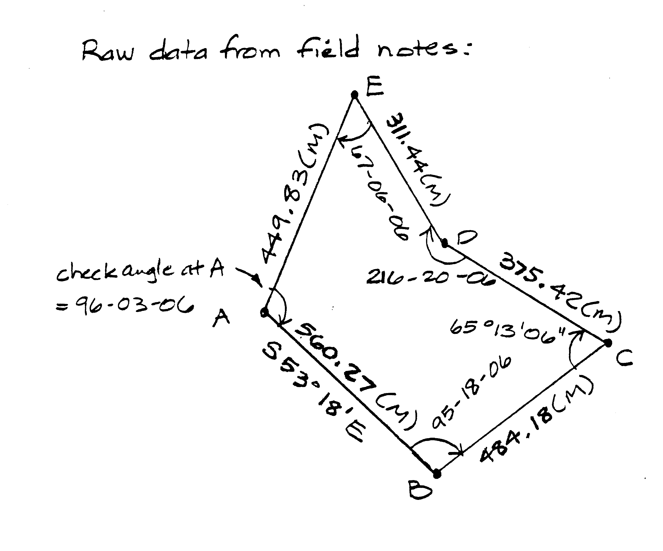
Example: Traverse Survey Adjustment by Compass Rule

Slide 21
Compass Rule procedure
Step 1: Compute angular error and balance angles
Step 2: Compute the bearings for each course (after angular closure)
Step 3: Compute the latitudes and departures
Step 4: Compute the error of closure
Step 5: Compute the ratio of error (relative accuracy)
Step 6: Compute the latitude and departure corrections for each course
Step 7: Adjust the latitudes and departures
Step 8: Recompute angles and bearings of traverse courses

Slide 22
Compass Rule Traverse Adjustment
 | Raw | Raw | Latitude |  | Adjusted | Departure |  | Adjusted
Point | Bearing | Distance | +/- | Correction | Latitude | +/- | Correction | Departure

Slide 23
6.9 Rectangular Coordinates
Define position with respect to orthogonal axes
Uses: State Plane Coordinate systems, Cad for plotting, construction staking
Format: N (Northing)
E (Easting)
If axes assumed, choose values so all points positive; i.e. select origin so that all points fall in the NE quadrant (1st quadrant) so that all coordinates in our system have positive x and positive y values.

Slide 24
Example: Given Pt. A at (200.00,300.00) using format (x,y) = (E,N)
Pt. B has bearing & distance from Pt. A = N 42 º 30‘ 30" E 300.00'
Find: Coordinates of Pt. B
Solution:
1) Find latitude and departure of line A-B
2) Add latitude and departure to respective values of Pt. A

Slide 25
6.10 Area Computations
How would you calculate the area of an irregular-sided, multi-cornered traverse?
(or lot boundary?)
Three common methods:
1) Double Meridian Distance Method
2) Double Parallel Distance Method
3) Coordinate Method

Slide 26
Example: Area by Coordinate Method
Point Coordinates
X Y
1 1000.00 1000.00
2 1236.11 492.03
3 817.72 248.31
4 782.01 622.01
5 574.45 854.35
Find the area of the lot.

